Slide 1

MONASH INFORMATION TECHNOLOGY
FIT5042 Week 7: Introduction to SpringMVC
Guan Xiaoxiang and Sunil Panda

Slide 2

This Week
Introduction to SpringMVC Next week
Advance Spring MVC
2

Slide 3
Introduction to SpringMVC

Slide 4
Introduction to SpringMVC
Spring is a Lightweight Application Framework where Struts, WebWork and others can be considered Web frameworks. Spring addresses all tiers of an application.

Slide 5
Core SpringMVC
Core technologies and concepts of Spring framework are:
IoC (Inversion of Control)
DI (Dependency Injection).
Auto wiring
AOP (Aspect Oriented Programming)
MVC (Model view controller)

Slide 6
Inversion of Control (IoC)
Single most important concept of Spring framework. IoC underpins a lot of functionalities provided by Spring.
Traditionaly, the control of logic, relationships and flow are usually defined and maintained within the application codes. In the IoC world, the control is handed over to Spring framework, which calls application code (usually POJO) instead of application calling the framework.
In Spring framework, the objects that are instantiated and managed by the Spring IoC Container are referred to as beans. These beans, together with their relationships and dependencies are defined in the configuration metadata (i.e. xml format) used by the container

Slide 7
DI (Dependency Injection)
Tightly coupled with IoC,
Typically, multiple classes work together to perform certain task(s), and hence inter-relate with each other in some sort of relationships.
Instead of defining the relationships within the application codes, these kinds of dependencies can be defined in the XML metadata configuration,
the container will be responsible to “inject” the relationships when the bean is created

Slide 8
Auto wiring
Spring IoC container is able to autowire relationships between collaborating beans.
It means the container will automatically resolve the bean relationships by inspecting the BeanFactory contents.
Autowiring in Spring happens at bean level, which means it is possible to autowire some beans in the container but not the others
Saves a significant amount of typing and maintenance effort of developers.

Slide 9
AOP (Aspect Oriented Programming)
Solutions are applied to those enterprise concerns, such as transaction management, which have traditionally been addressed by EJB.
The goal of Spring's AOP support is to provide J2EE services to POJOs.
Spring AOP is portable between application servers, it works in either web or EJB container.

Slide 10
MVC (Model view controller)

Slide 11
Spring MVC Framework
Provides model-view-controller architecture.
Components, to develop flexible and loosely coupled web applications.
separating aspects of the application (input logic, business logic, and UI logic), while providing a loose coupling between these elements.
11

Slide 12
Spring MVC Framework
The Model
encapsulates the application data and in general they will consist of POJO.
The View
is responsible for rendering the model data and in general it generates HTML output that the client's browser can interpret.
The Controller
is responsible for processing user requests and building appropriate model and passes it to the view for rendering.
12

Slide 13

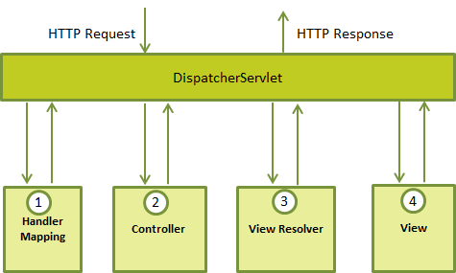
DispatcherServlet
13

Slide 14

Sequence of events corresponding to incoming HTTP request to DispatcherServlet
After receiving an HTTP request, DispatcherServlet consults theHandlerMapping to call the appropriate Controller.
The Controller takes the request and calls the appropriate service methods based on used GET or POST method. The service method will set model data based on defined business logic and returns view name to the DispatcherServlet.
The DispatcherServlet will take help from ViewResolver to pickup the defined view for the request.
Once view is finalized, The DispatcherServlet passes the model data to the view which is finally rendered on the browser.
14

Slide 15
WebApplicationContext
The above components ie. HandlerMapping, Controller and ViewResolver are parts of WebApplicationContext which is an extension of the plain ApplicationContext with some extra features necessary for web applications.
15

Slide 16
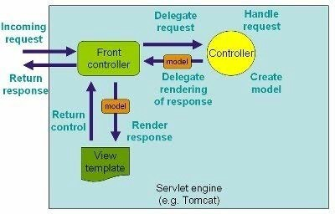
Flow Control - Request Processing Lifecycle
15

Slide 17
Request process lifecycle of Spring MVC:
The client sends a request to web container in the form of http request.
This incoming request is intercepted by Front
controller (DispatcherServlet) and it will then tries to find out appropriate Handler Mappings.
With the help of Handler Mappings, the DispatcherServlet will dispatch the request to appropriate Controller.
The Controller tries to process the request and returns the Model and View object in form of ModelAndView instance to the Front Controller.
The Front Controller then tries to resolve the View (which can be JSP, Freemarker, Velocity etc) by consulting the View
Resolver object.
6. The selected view is then rendered back to client.
16

Slide 18
Spring MVC application

Slide 19
Creating a Spring MVC application
1. Configure the web.xml and Dispatcher servlet
2. Configure the web and application context.
3. Configure the controllers, view resolvers in web application context.
4. Configure business logic and other beans
(Data access Object , Service Beans) in application context.
5. Create views.
6. Create Controllers.

Slide 20
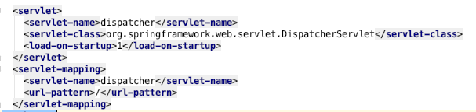

Configuration – dispatcher servlet
You need to map requests that you want the DispatcherServlet to handle, by using a URL mapping in the web.xml file. The following is an example to show declaration and mapping for dispatcher DispatcherServlet example:

Slide 21
Configuration – application context
After initialization of dispatcher DispatcherServlet, the framework will try to load the application context from a file named [dispatcher]-servlet.xml located in the application's WebContent/WEB-INF directory.
Next, <servlet-mapping> tag indicates what URLs will be handled by the which DispatcherServlet. Here all the HTTP requests with root ‘/’ will be handled by the dispatcher DispatcherServlet.
After the welcome file loads the index.jsp , it can then be designed to navigate or redirect to some other page eg. Below redirects to page index.htm.

Slide 22
Configuration – HandlerMapping and ViewController
when index.htm request comes , dispatcher will find appropriate controller. From the request url the handler mapping will find the appropriate controller. In the below example it is indexController.
Then it will find the controller – indexController , here in our case it will find the parameterizable controller. This controller simply forwards the request to the view – index i.e index.jsp without doing any logic.
Note: Best practice is to use controller classes and not wire everything in configuration.

Slide 23
Configuration – ViewResolver
To find the appropriate view – index.jsp it will look in viewResolver. In the viewresolver it will look for the resource index in /WEB-INF/jsp folder with a file extension .jsp

Slide 24
Important Information
The [dispatcher]-servlet.xml file will be used to create the beans defined, overriding the definitions of any beans defined with the same name in the global scope.
The <context:component-scan...> tag will be use to activate Spring MVC annotation scanning capability which allows to make use of annotations like @Controller and @RequestMapping etc.
The InternalResourceViewResolver will have rules defined to resolve the view names. As per the above defined rule, a logical view named hello is delegated to a view implementation located at /WEB-INF/jsp/hello.jsp .

Slide 25
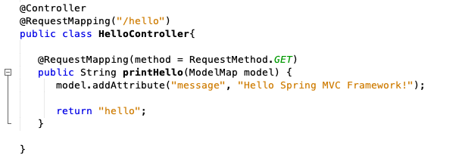
Controller
DispatcherServlet delegates the request to the controllers to execute the functionality specific to it.
The @Controller annotation indicates that a particular class serves the role of a controller.
The @RequestMapping annotation is used to map a URL to either an entire class or a particular handler method.

Slide 26
Model
Based on the business logic defined, you will create a model within this method. You can setter different model attributes and these attributes will be accessed by the view to present the final result. This example creates a model with its attribute "message".
A defined service method can return a String which contains the name of the view to be used to render the model. This example returns "hello" as logical view name

Slide 27
Views
Spring MVC supports many types of views for different presentation technologies. These include - JSPs, HTML, XML, Velocity templates, XSLT, JSON,etc. It also has integration with JSF framework as well.

Slide 28
Benefits of Spring

Slide 29
Benefits - a
Spring can effectively organize middle tier objects, whether or not EJB has been chosen to use. Spring takes care of plumbing that would be left up to developer if he/she uses only Struts or other frameworks geared to particular J2EE APIs. And while it is perhaps most valuable in the middle tier, Spring's configuration management services can be used in any architectural layer, in whatever runtime environment.
Spring can eliminate the increase of Singletons seen on many projects; this is a major problem, reducing testability and object orientation.
Spring can eliminate the need to use a variety of custom properties file formats, by handling configuration in a consistent way throughout applications and projects. Ever wondered what magic property keys or system properties a particular class looks for, and had to read the Javadoc or even source code, With Spring developer simply look at the class's JavaBean properties or constructor arguments. The use of Inversion of Control and Dependency Injection helps achieve this simplification.

Slide 30
Benefits - b
Spring can facilitate good programming practice by reducing the cost of programming to interfaces, rather than classes, almost to zero.
Spring is designed so that applications built with it depend on as few of its APIs as possible. Most business objects in Spring applications have no dependency on Spring.
Applications built using Spring are very easy to unit test.
Spring can make the use of EJB an implementation choice, rather than the determinant of application architecture. Developer can choose to implement business interfaces as POJOs or local EJBs without affecting calling code.

Slide 31
Benefits - c
Spring helps to solve many problems without using EJB. Spring can provide an alternative to EJB that's appropriate for many applications. For example, Spring can use AOP to deliver declarative transaction management without using an EJB container; even without a JTA implementation, if developer only needs to work with a single database.
Spring provides a consistent framework for data access, whether using JDBC or an O/R mapping product such as TopLink, Hibernate or a JDO implementation.
Spring provides a consistent, simple programming model in many areas, making it an ideal architectural "glue." Developer can see this consistency in the Spring approach to JDBC, JMS, JavaMail, JNDI and many other important APIs.

Slide 32
Spring and EJB comparison

Slide 33
Spring and EJB comparison
Use Spring if:
Your application requires fine-grained control at the container level.
Your application requires a lot of configuration beyond gluing together components and resources.
You need advanced AOP features.
Use EJB 3 if:
You like annotations and dislike a lot of XML configuration.
You prefer a tightly integrated solution stack that makes sensible default choices for you and minimizes configuration.
Your application is very stateful.
Standardization is an important consideration.
You use JSF and are considering using Seam.
33

Slide 34
Conclusion
EJB based application are monolithic in nature and scaling of application middleware becomes a big issue in enterprise environment.
Spring gives you more flexibility in many aspects of application development than EJB does— and this is particularly true with regards to persistence and transaction providers. But the trade-off for this added flexibility is increased complexity in configuration. EJB 3.0 provides less flexibility but its tight technology stack, annotations-based configuration, and philosophy of configuration by exception make configuring EJB 3.0 applications quite simple.
Standardization: While Spring integrates many standards such as JTA, JDBC, and JMS it is not itself a Java standard. When standardization (and by extension vendor support, tooling, etc.) is important to our organization or application then it is good to simply go with EJB 3.0

Slide 35
Summary
This Week:
Introduction to SpringMVC
Next Week:
Spring MVC, MySql and Tomcat
Building a web application and doing CRUD operation.
35

Slide 36

Seeyou in the Studio !

